Slide 1

Web Fundamentals Project
By student
Mohamed Amine Soudane

Slide 2
Table of content
How does the web work?
What do i need to be a web developer?
Why did i choose to be a web developer?

Slide 3
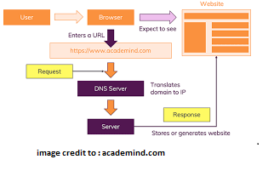
How does the web work ?
The web (World Wide Web) is a way of sharing information over the internet.
The web is not the internet : it is rather a subset of internet created in 1989 by Sir Tim Berners-Lee.
The web is a body of information stored on servers either harwdware or software. The information can be manipulated following this typical path:
Notes:
1- Request a web page by typing its URL in the browser.
2-The browser sends a request to the DNS server to translate the domain to its corresponding IP adress.
3-An HTTP request is sent to the corresponding server.
4- Depending on the verb in the HTTP request, the server stores, generates, updates or deletes the information.
5- The server sends back a response message to the client side to be displayed on the browser.

Slide 4
What do i need to be a web developer ?
To become a web developer i need to develop a certain logical mindset and master specific skills related to programming languages and frameworks such as HTML, CSS, JavaScript and React JS.
Becoming a web developer is a challenging journey that needs essential personal features such as patience, dedication and willingness to learn.
In order to start this journey, i’ll need to set a proper development environment by providing and setting up some essential tools:
a web browser (Google Chrome), a code editor (Visual Studio Code) and a version control and repository (Git and Github)

Slide 5
Why did i choose to become a web developer ?
I chose to become a web developer mainly for the following reasons:
Reason | Explanation
Web developers are in demand | Work statistics show that web development industry is expected to still be growing faster than any other field.
Good salary expectation | Web developers make fair wages on their entry level compared to other industries and their salaries are rapidly increasing with experience.
Being part of a community | The online community of web developers is huge. It’s always rewarding to be part of a like-minded community both on the social and professional levels.
Flexibilty | Unlike other professions, all it takes to work as a web developer is a personal computer and internet connection. I can manage to work from anywhere and on a flexible time frame especially if i go freelance.

